Slide 1
Safe Platooning of Unmanned Aerial Vehicles via Reachability
Mo Chen, Qie Hu, Casey Mackin, Jaime Fisac, Claire Tomlin
UC Berkeley, USA
Thursday, December 17, 2015
Multivehicle Systems, CDC 2015
Notes:
Hello everyone. Welcome to my talk on Safe Platooning of Unmanned Aerial Vehicles via Reachability. This work is a collaboration with my colleagues Qie, Casey, Jaime, and my professor Claire Tomlin.

Slide 2
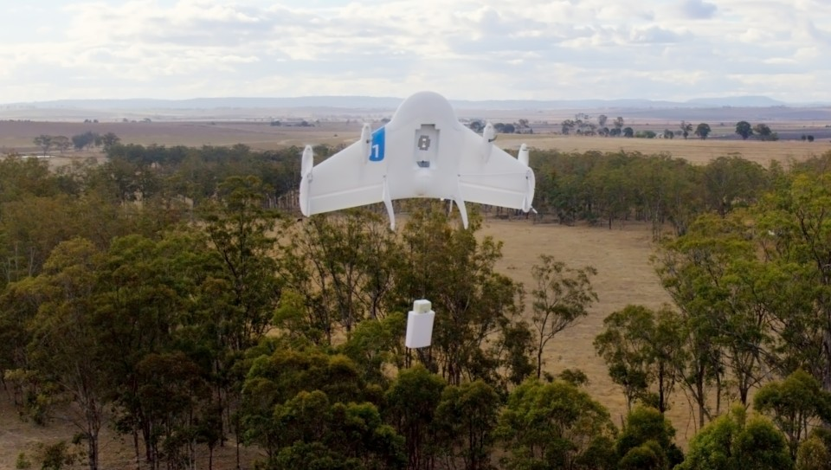
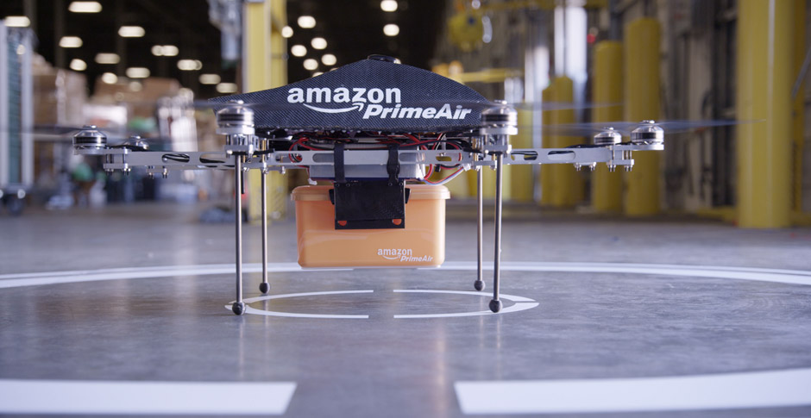
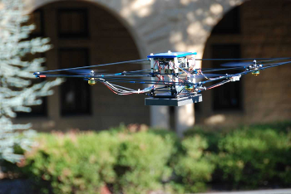
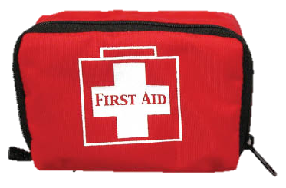
Motivation
Aerial surveillance
Google Project Wing
Amazon Prime Air
Emergency Supply Delivery
Search and rescue
Notes:
Recently, there have been immense interest in using UAVs for civil purposes such as package delivery, emergency supply delivery, aerial surveillance, and search and rescue. In the future, the uses of UAVs are only limited by our imagination.

Slide 3
Motivation
Many UAVs
City with 2 million people
Each person requests drone delivery every 2 months
~35000 deliveries per day
30 minutes from warehouse to customer
Thousands of drones in the air simultaneously
Large joint state space
Even pairwise interactions are numerous
Platoons provide additional structure to facilitate scalable analysis
Notes:
There are many challenges in using UAVs for civil purposes. Take a hypothetical city with a population of 2 million, in which each person requests drone delivery of a package every 2 months. This equates to about 35000 deliveries per day. If each delivery takes 30 minutes from warehouse to customer, we would have thousands of drones, or UAVs simultaneously in the air.
The large joint state space of this many UAVs makes traditional dynamic programming approaches for guaranteeing safety intractable. Even if we were to limit ourselves to pairwise analysis, many pairs of vehicles would need to be considered.
Putting many of these UAVs into platoons imposes the additional structure that facilitates any kind of scalable analysis.

Slide 4
Motivation
Important and urgent problem for government agencies
Working with NASA Ames to address the UAV traffic management (UTM) problem

Slide 5
Goals
Air highways
Platooning
Vehicles and platoons as hybrid systems
Reachability analysis
Hamilton-Jacobi formulation
Liveness controllers
Safety controllers
Simulations
Notes:
The goals of this presentation is to briefly introduce ideas of air highway placement, platooning, and using reachability analysis in the context of platooning. We will finish the presentation with simulations.

Slide 6
Goals
Air highways
Platooning
Vehicles and platoons as hybrid systems
Reachability analysis
Hamilton-Jacobi formulation
Liveness controllers
Safety controllers
Simulations
Notes:
Let's start with air highway placement

Slide 7
The cost of flying
San Francisco Bay Area
Example cost map

Slide 8
Minimizing cost
Accidents
Fuel
Noise pollution
Fast marching method
“Trunks” and “Branches” in optimal paths
Cost map, value function, and optimal paths
Notes:
Air highways should not only connect destinations to origins, but also minimize some cost such as accidents, fuel, and and so on. In order to incorporate these costs, we used the fast marching method for air highway placement

Slide 9
Air Highways
Fast marching method outputs a continuous sequence of points
Junction points are identified
Creates a sparse set of waypoints
End points of highways
Bay Area map and waypoints
Notes:
The red paths we saw were actually a continuous sequence of points.

Slide 10
Air highways
Fast marching method outputs a continuous sequence of points
Junction points are identified
Creates a sparse set of waypoints
End points of highways
Bay Area map and waypoints
Notes:
After identifying junction points, and showing the resulting sparse set of waypoints on the San Francisco Bay Area map, we can see what the highways could look like.

Slide 11
Air Highways
Straight-line paths inside a pre-defined altitude range
Connects destinations and origins
Platoons travel on air highways
Notes:
We consider an air highway to be a path inside a pre-defined altitude range. UAV platoons would travel on air highways to move from an origin to a destination

Slide 12
Goals
Air highways
Platooning
Vehicles and platoons as hybrid systems
Reachability analysis
Hamilton-Jacobi formulation
Liveness controllers
Safety controllers
Simulations
Notes:
Next, we'll discuss the concept of platooning

Slide 13
Platoons
Vehicles traveling in a single-file formation
Leader follows the highway
Followers use simple feedback control to stay in formation
Simple control laws are used

Slide 14
Vehicle modes
Free
Vehicle not in a platoon or on a highway
Notes:
We model vehicles as a hybrid system. At any given time, a vehicle in the airspace could be in one of several modes. When the vehicle is not part of a platoon or not flying on a highway, it is "Free"

Slide 15
Vehicle modes
Follow highway
Leave highway
Leader
Leader of platoon
Merge onto highway
Free
Vehicle not in a platoon or on a highway
Notes:
When a vehicle joints a highway, it becomes a "leader".

Slide 16
Vehicle modes
Follow highway
Leave highway
Leader
Leader of platoon
Create new platoon
Follow platoon
Merge onto highway
Join platoon in front
Free
Vehicle not in a platoon or on a highway
Follower
Member of platoon
Join platoon
Leave highway
Notes:
A free vehicle could also join a platoon that is on the highway to become a "follower". There are many other maneuvers for switching from any mode to any other.

Slide 17
Vehicle modes
Follow highway
Leave highway
Leader
Leader of platoon
Create new platoon
Follow platoon
Merge onto highway
Join platoon in front
Free
Vehicle not in a platoon or on a highway
Follower
Member of platoon
Join platoon
Leave highway
Faulty
Descends after 2 seconds
Notes:
We add a fourth mode called "faulty" to represent vehicles that are not behaving normally, and assume that they will descend after 2 second.

Slide 18
Vehicle modes
How do we guarantee safe and successful transition between these modes
Follow highway
Leave highway
Leader
Leader of platoon
Create new platoon
Follow platoon
Merge onto highway
Join platoon in front
Free
Vehicle not in a platoon or on a highway
Follower
Member of platoon
Join platoon
Leave highway
Faulty
Descends after 2 seconds

Slide 19
Goals
Air highway placement
Platooning
Vehicles and platoons as hybrid systems
Reachability analysis
Hamilton-Jacobi formulation
Liveness controllers
Safety controllers
Simulations
Notes:
Next, we will look at how reachability is used to perform the mode transitions

Slide 20
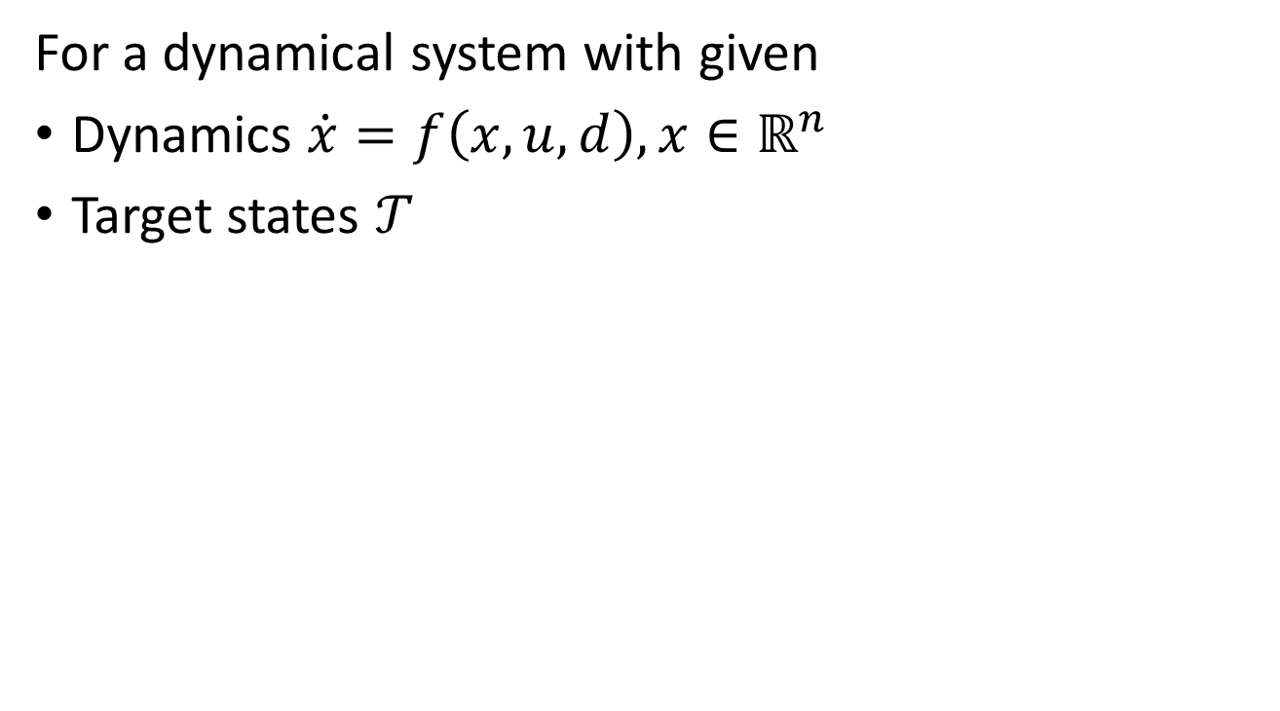
Reachability Analysis
For a dynamical system with given
Dynamics $\dot{x}=f\left(x,u,d\right),x∈ℝ^{n}$
Target states $𝒯$
Determines, with guarantees
Set of states from which the system can be driven to the target state Optimal control
Reachable set
Target set
Notes:
In reachability analysis, some system dynamics is given through an ODE, and a target set is specified

Slide 21
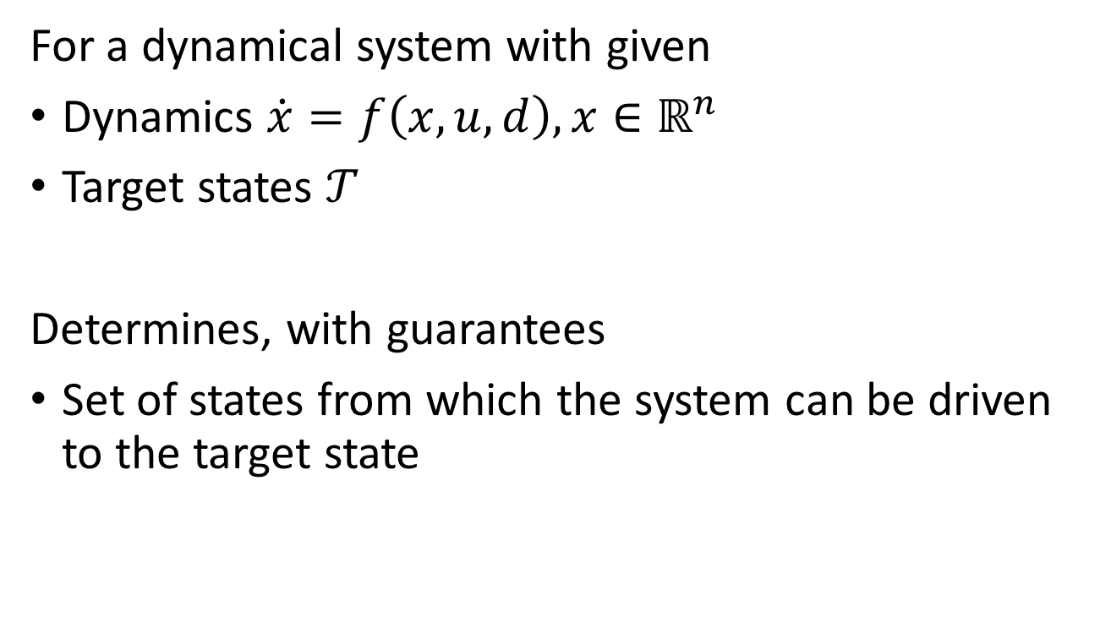
Reachability Analysis
For a dynamical system with given
Dynamics $\dot{x}=f\left(x,u,d\right),x∈ℝ^{n}$
Target states $𝒯$
Determines, with guarantees
Set of states from which the system can be driven to the target state
Reachable set
Target set
Notes:
From the target set, the reachable set is determined. The reachable set is the set of states from which the system can be driven to the target state. It can be used to model a desired set of states, or an undesirable set of states, depending on the application.

Slide 22
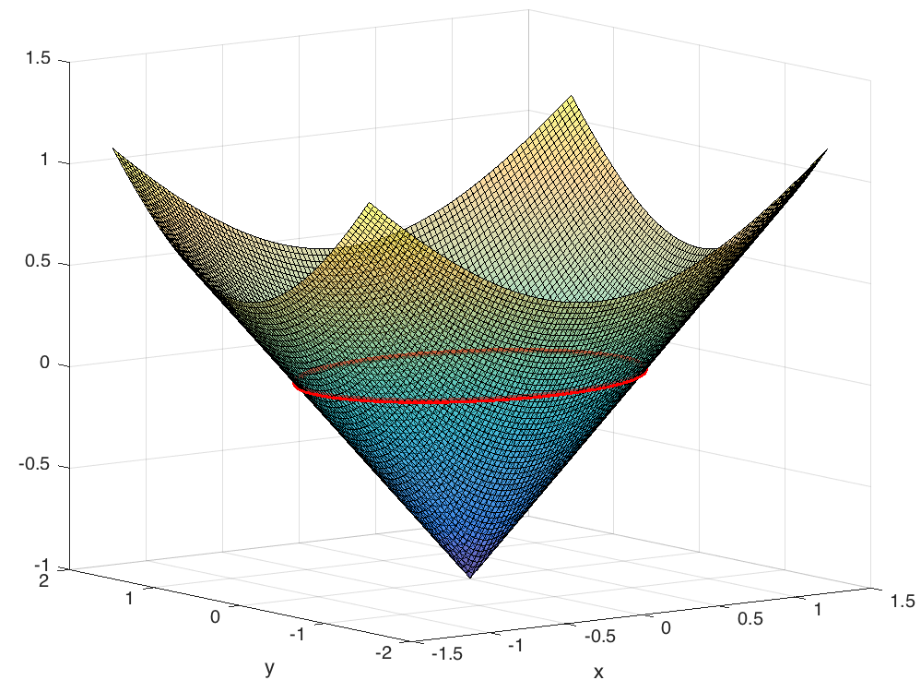
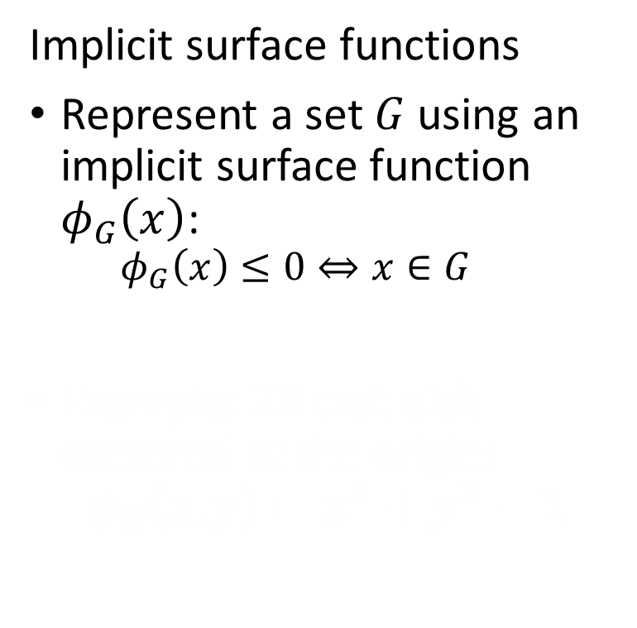
Hamilton-Jacobi Formulation
Implicit surface functions
Represent a set $G$ using an implicit surface function $φ_{G}\left(x\right)$:
$$φ_{G}\left(x\right)≤0⇔x∈G$$
Example: 2D unit disk centered at the origin:
$$φ_{G}\left(x,y\right)=x^{2}+y^{2}−1$$
Notes:
In the Hamilton-Jacobi approach, sets are represented by the sub-0 level set of some function. This figure shows a function one may use to represent a unit disk

Slide 23
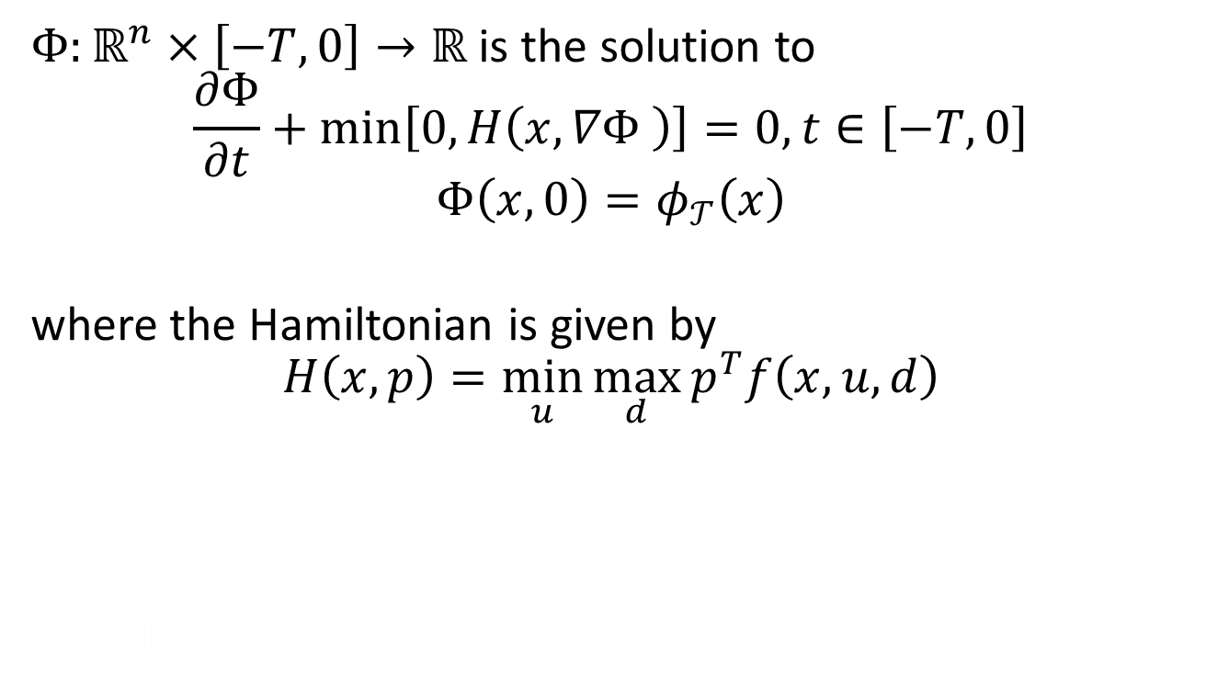
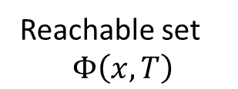
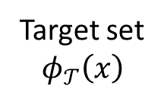
Hamilton-Jacobi Formulation
$Φ:ℝ^{n}×\left[−T,0\right]→ℝ$ is the solution to
$$\frac{∂Φ}{∂t}+min\left[0,H\left(x,∇Φ \right)\right]=0, t∈\left[−T,0\right]$$
$$Φ\left(x,0\right)=φ_{𝒯}\left(x\right)$$
where the Hamiltonian is given by
$$H\left(x,p\right)=\min_{u}{\max_{d}{p^{T}f\left(x,u,d\right)}}$$
Optimal controls given by optimizers of Hamiltonian
Toolbox of Level Set Methods^{[2]}
Reachable set
$$Φ\left(x,T\right)$$
Target set
$$φ_{𝒯}\left(x\right)$$
Notes:
To compute the reachable set, we solve the Hamilton-Jacobi partial differential equation, which is shown here. The important thing here is that the solution to the PDE is an implicit surface function for the reachable set.
From the solution to the PDE, one can also extract the optimal controls from the argument min and max of the expression for the Hamiltonian.

Slide 24
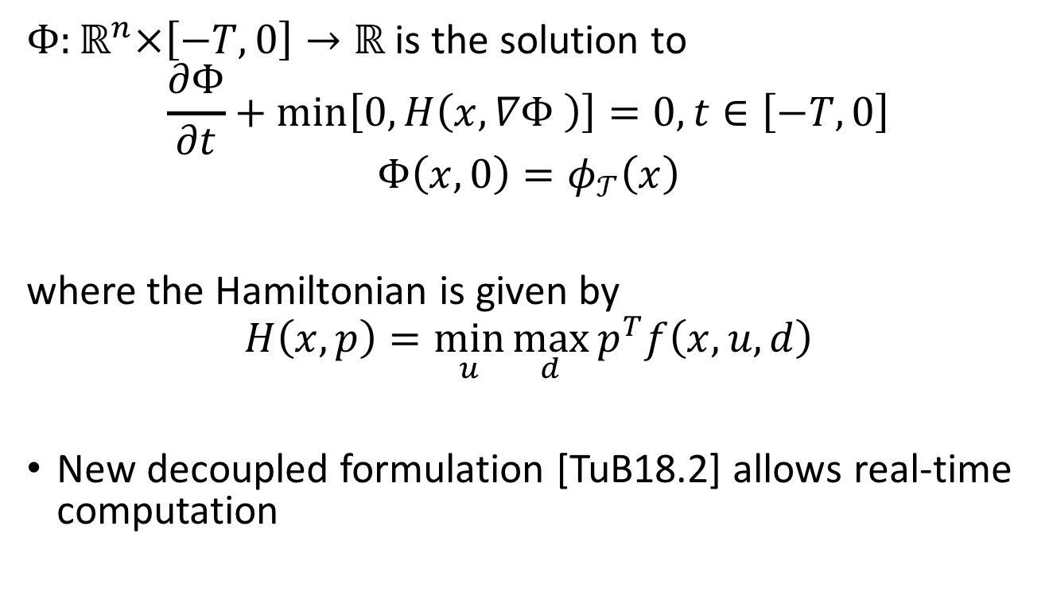
Hamilton-Jacobi Formulation
$Φ:ℝ^{n}×\left[−T,0\right]→ℝ$ is the solution to
$$\frac{∂Φ}{∂t}+min\left[0,H\left(x,∇Φ \right)\right]=0, t∈\left[−T,0\right]$$
$$Φ\left(x,0\right)=φ_{𝒯}\left(x\right)$$
where the Hamiltonian is given by
$$H\left(x,p\right)=\min_{u}{\max_{d}{p^{T}f\left(x,u,d\right)}}$$
New decoupled formulation [TuB18.2] allows real-time computation
^{placeholder}
Reachable set
$$Φ\left(x,T\right)$$
Target set
$$φ_{𝒯}\left(x\right)$$
Notes:
To compute the reachable set, we solve the Hamilton-Jacobi partial differential equation, which is shown here. The important thing here is that the solution to the PDE is an implicit surface function for the reachable set.
From the solution to the PDE, one can also extract the optimal controls from the argument min and max of the expression for the Hamiltonian.

Slide 25
Liveness controllers from reachable sets
Merging onto a highway
Target set: desired merging position and velocity
Reachable set: set of states that can reach target set
Joining platoon on highway
Target set: desired merging point in terms of relative coordinates
Reachable set: set of states in relative coordinates that can reach target set
Controller
Take straight line towards target until vehicle is inside reachable set
Use optimal control from reachable set once vehicle is inside reachable set
Leader
Leader of platoon
Merge onto highway
Free
Vehicle not in a platoon or on a highway
Notes:
We can now apply Hamilton-Jacobi reachability to construct liveness controllers. For each controller, we can simply specify the target set, compute the reachable set, and the obtain the optimal control.
For the merging onto highway operation, we define the target set to be the position of the desired merging point, along with the desired heading. This operation allows a free vehicle to become a leader

Slide 26
Liveness controllers from reachable sets
Merging onto a highway
Target set: desired merging point and relative velocity
Reachable set: set of states that can reach target set
Joining platoon on highway
Target set: desired merging point in terms of relative coordinates
Reachable set: set of states in relative coordinates that can reach target set
Controller
Take straight line towards target until vehicle is inside reachable set
Use optimal control from reachable set once vehicle is inside reachable set
Free
Vehicle not in a platoon or on a highway
Follower
Member of platoon
Join platoon
Notes:
For the joining platoon operation, which allows a leader or a free vehicle to become a follower, we define the target set to be a position behind a platoon leader, with small relative velocity with respect to the leader.

Slide 27
Safety controllers
Collision avoidance
Target set: collision box in relative states plus (union) velocity limits
Reachable set: set of states in relative coordinates that will hit target set assuming worst case disturbance
Controller
Use liveness controller if safe
Use safety controller if not safe
Notes:
The previous liveness controllers can only be performed if the vehicle is safe with respect to all vehicles with whom safety is checked. For the safety controller, we define the target set to be the collision box in relative states. In addition, we specify velocity limits for each vehicle. In this case, the target set is an undesirable set of states, and we therefore need to avoid the reachable set to ensure collision avoidance.

Slide 28
Safety controllers
Collision avoidance
Target set: collision box in relative states plus (union) velocity limits
Reachable set: set of states in relative coordinates that will hit target set assuming worst case disturbance
Controller
Use liveness controller if safe
Use safety controller if not safe
Notes:
Whenever a vehicle is outside of the safety reachable set of other vehicles, it may use a liveness controller; otherwise, the safety controller must be used.

Slide 29
Goals
Air highways
Platooning
Vehicles and platoons as hybrid systems
Reachability analysis
Hamilton-Jacobi formulation
Liveness controllers
Safety controllers
Simulations
Notes:
Let’s now look at how the platooning idea works in simulations

Slide 30
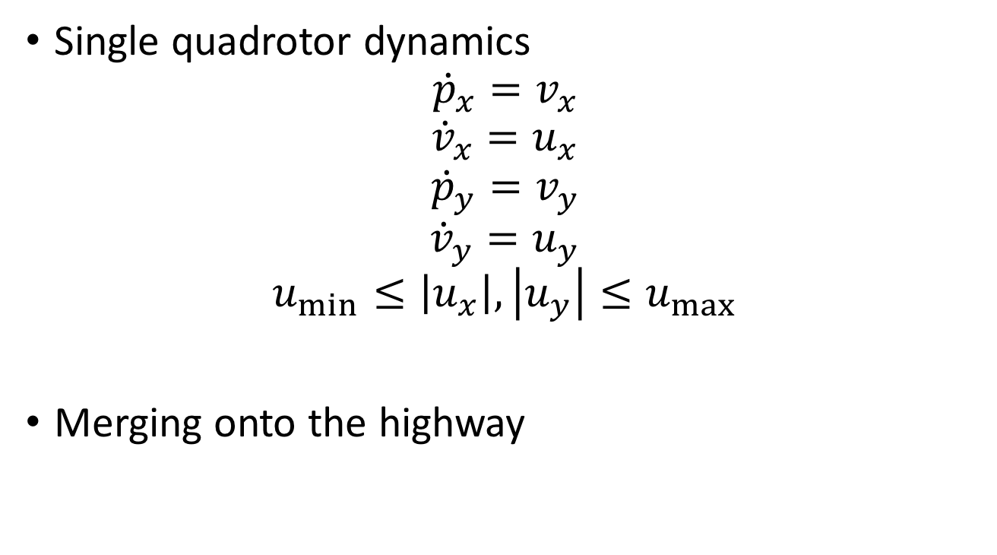
Dynamics
Single quadrotor dynamics
$${\dot{p}}_{x}=v_{x}$$
$${\dot{v}}_{x}=u_{x}$$
$${\dot{p}}_{y}=v_{y}$$
$${\dot{v}}_{y}=u_{y}$$
$$u_{min}≤\left|u_{x}\right|,\left|u_{y}\right|≤u_{max}$$
Merging onto the highway
Notes:
Consider a quadrotor modeled using double integrator dynamics. The quadrotor has a bounded acceleration in both the x and y directions. This model is used for computing the reachable set for merging onto the highway
i is evader, j is pursuer

Slide 31
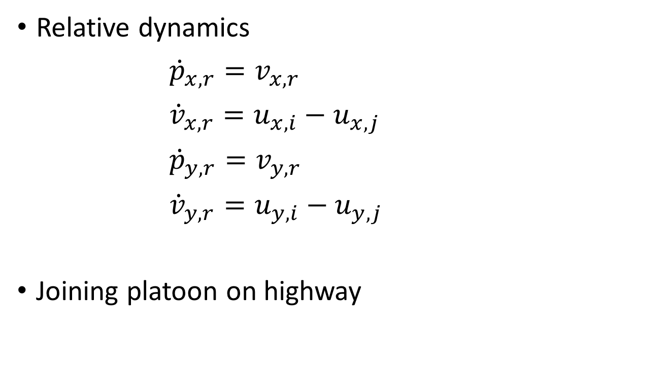
Dynamics
Relative dynamics
${\dot{p}}_{x,r}=v_{x,r}$
${\dot{v}}_{x,r}=u_{x,i}−u_{x,j}$
${\dot{p}}_{y,r}=v_{y,r}$
${\dot{v}}_{y,r}=u_{y,i}−u_{y,j}$
Joining platoon on highway
Notes:
For the joining platoon operation, we used the relative dynamics of two quadrotors in order to specify a target set relative to a platoon leader

Slide 32
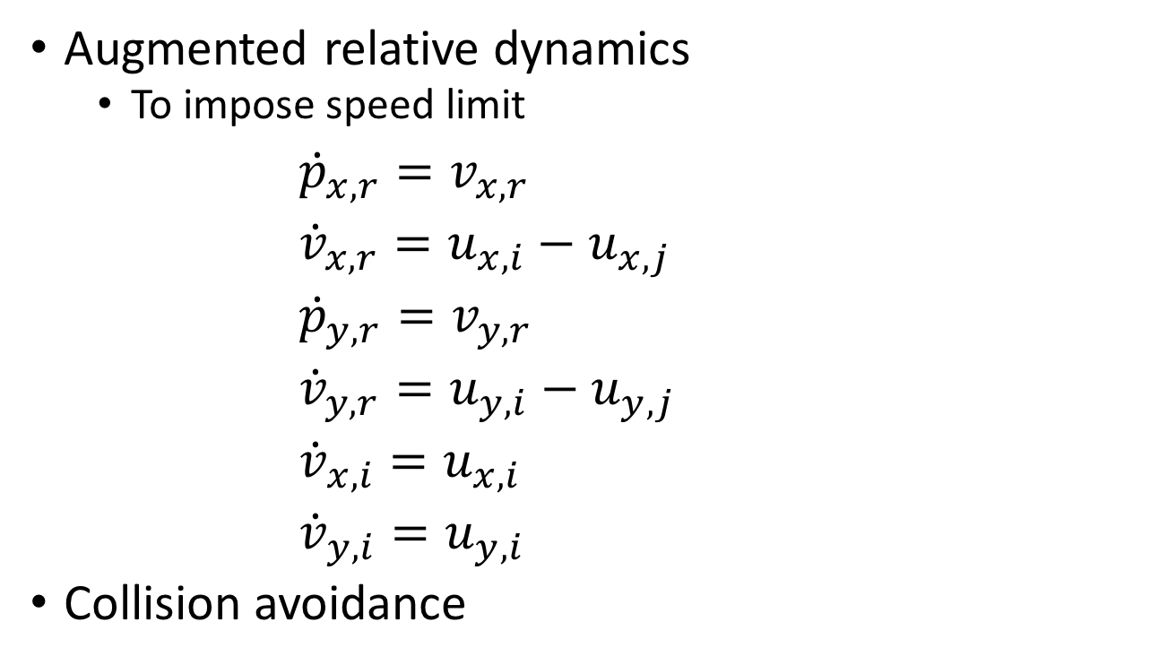
Dynamics
Augmented relative dynamics
To impose speed limit
${\dot{p}}_{x,r}=v_{x,r}$
${\dot{v}}_{x,r}=u_{x,i}−u_{x,j}$
${\dot{p}}_{y,r}=v_{y,r}$
${\dot{v}}_{y,r}=u_{y,i}−u_{y,j}$
${\dot{v}}_{x,i}=u_{x,i}$
${\dot{v}}_{y,i}=u_{y,i}$
Collision avoidance
Notes:
For collision avoidance, we augmented the relative dynamics with the velocity of vehicle i. This is needed to impose a speed limit on the evading vehicle.

Slide 33
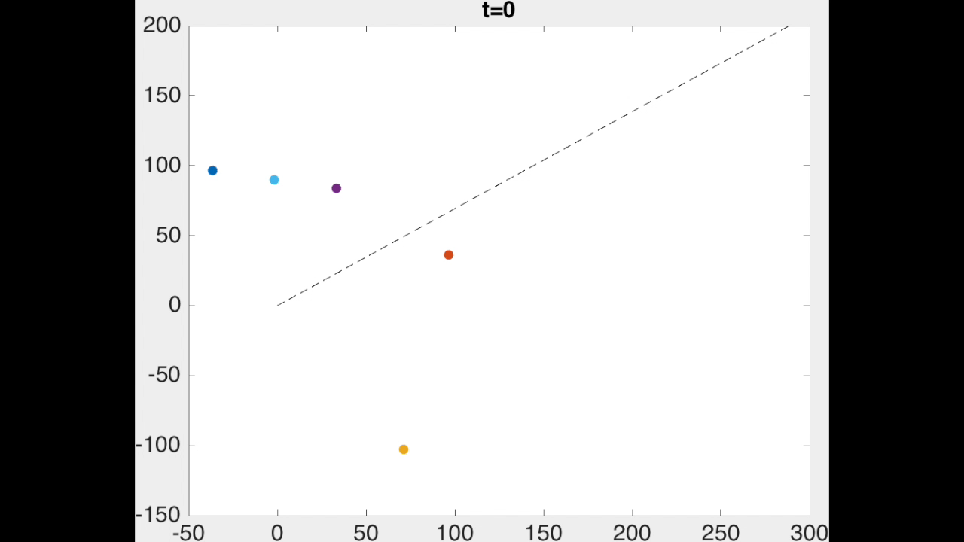
Liveness and Safety
Safety reachable set:
dashed boundaries
Liveness reachable set:
dotted boundaries
Sequence of events:
First vehicle merges onto highway
Second vehicle joins the platoon created by the first vehicle
The rest of the vehicles join the platoon
Notes:
In this simulation, first the red vehicle merges onto the highway to become a platoon leader. The red vehicle must first move into the reachable set for merging onto the highway, the dotted red boundary. When it it is inside the reachable set, it follows the optimal control to the target, as long as it stays outside of the safety reachable set, shown as the dashed red lines.
Next, the blue vehicle joins the platoon that the red vehicle just formed. Again, the vehicle first goes into the reachable set for joining a platoon, the blue dotted boundary. Afterwards, it follows the optimal control to the target destination. All this time, it avoids going into the safety reachable set, blue dashed boundary.

Slide 34
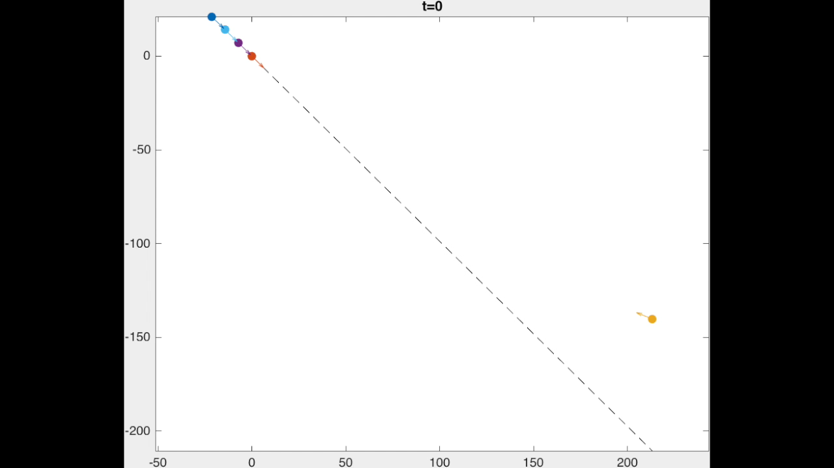
Intruder!
Vehicles automatically perform maneuvers to avoid collision
Safety is guaranteed by reachable set
Vehicles automatically re-establish formation
Liveness reachable sets guarantee success
Notes:
In this simulation, we have a 4-vehicle platoon travelling on a highway when they come across an intruder. The leader is unaffected, but the other three vehicles deviate from the highway to avoid collision with the intruder. The avoidance maneuver is given by the safety reachable set.

Slide 35
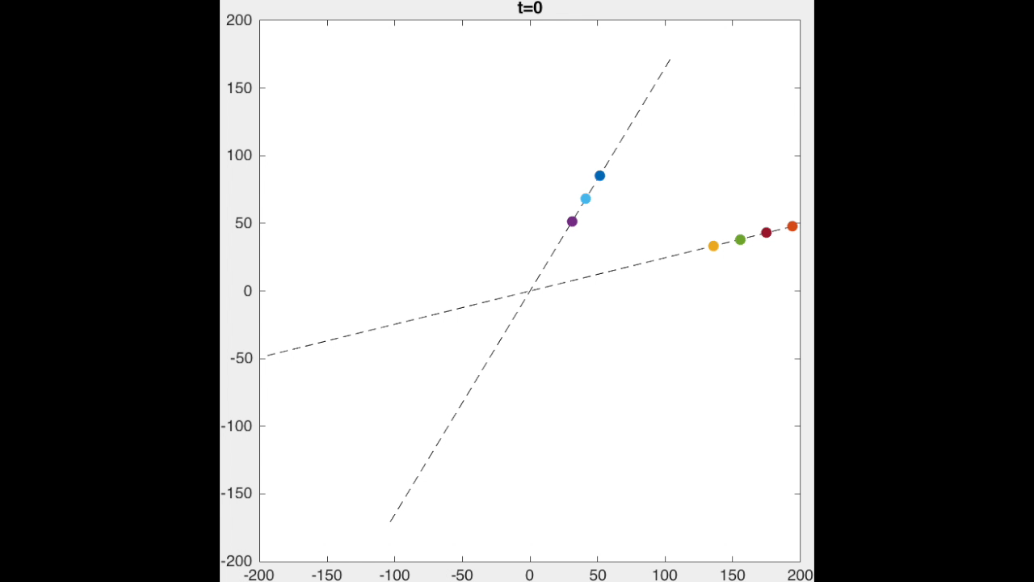
Two highways simulation
Two highways
One with a 3-vehicle platoon
The other with a 4-vehicle platoon.
2 vehicles in the 4-vehicle platoon changes highways
The remaining 2 vehicles remain on the same highway.
Notes:
In the last simulation, we have two highways, each with a platoon. Two of the vehicles on the diagonal highway leave their platoon to merge with the platoon on the horizontal highway.

Slide 36
Summary
Air highway placement
Vehicles modeled as hybrid systems
Reachability analysis for guaranteeing safety and mode transitions
Notes:
In summary, we proposed a method for placing air highways for vehicle platoons to travel on, and modeled the vehicles as hybrid systems. We used reachability analysis to guarantee safety as well as successful mode transitions.

Slide 37
Thank you!
mochen72@berkeley.edu

Slide 38
Platoons
Platoon
vehicle
Merge with another platoon
Add vehicle
vehicle
(Disbanded)
Platoon
vehicle
Remove vehicle
vehicle
Notes:
A platoon can add or remove vehicles, or merge with another platoon

Slide 39
Platoons
Platoon
vehicle
vehicle
vehicle
vehicle
Notes:
In our work, we consider a platoon to be a sequence of vehicles that fly in a single file formation.

Slide 40
Total number of safety checks
In general, a vehicle must make sure it is safe with respect to every other vehicle.
Suppose each platoon member checks safety with only the vehicle in front and behind…
Notes:
In general, each vehicle must make sure it is safe with respect to every other vehicle. Without any structure, the number of safety checks needed would be N choose 2, which scales quadratically with N, the number of vehicles, as shown in this plot.
Here, the y axis is the number of safety checks needed, and the x axis is the number of vehicles. The different curves represent different fractions of vehicles in platoons. If we assume that platoon members only check safety with respect to the vehicles in front and behind, then we can substantially reduce the number of safety checks

